Slide 1
Chapter 6 Anesthesia for gynecologic tumors and non-obstetric surgery during pregnancy

Slide 2
Objectives
Explain the anesthetic considerations for gynecologic surgeries
Explain the anesthetic considerations for pregnant women having non obstetrics surgery

Slide 3
Gynecological surgeries

Slide 4
Ovarian cancer
Introduction
Stages
Risk factors
Sign and symptom
Diagnosis
Treatment
Surgery
Chemotherapy
Radiotherapy

Slide 5
Ovarian carcinoma
Introduction
Ovarian carcinoma has the highest mortality rate of all gynecologic malignancies → discovered in advanced stages
Wide spread intra-abdominal metastasis to lymph nodes, omentum and peritoneum are often present
Surgery is indicated for resection of localized tumor and for staging of distant and local metastases
Additional procedures including bowel resection or lymph node dissection may be performed at the same time

Slide 6
Anesthetic consideration
Respiratory
Significant ascites and pleural fluid may produce respiratory compromise
The presence of dyspnea, orthopnea or other chest findings need to be investigated
Underlying lung diseases such as asthma - exacerbated by the abdominal distension/ascites
Consider chest x-ray, others as indicated from history and physical examination

Slide 7
…cont’d
Cardiovascular
An ECHO or other studies to evaluate cardiac function
Look for preexisting cardiac disease or exercise intolerance
Irreversible dose dependent cardio toxicity may result from doxorubicin chemotherapy

Slide 8
…cont’d
Gastrointestinal
Patient should have adequate preop. IV hydration if given a bowel preparation overnight
Opioid use may cause a decrease in GI motility
May be malnourished
Neurological
Not usually significant
Taxol and cisplatin may cause peripheral neuropathy

Slide 9
Hematology
Bone marrow suppression common following chemotherapy
Carboplatin, commonly used for ovarian cancer often induces thrombocytopenia…test CBC
Laboratory
CBC, hepatic function, PT/PTT, order blood for transfusion

Slide 10
General preparation
Prepare blood for transfusion
Open two big IV lines
Warm all IV fluids

Slide 11
Intraoperative
Anesthesia technique – GA ± epidural analgesia
Induction – standard induction, consider full stomach precaution if ascites present
Maintenance – inhalational + opioids + muscle relaxants… ± epidural analgesia
- maintain fluid balance and consider blood
transfusion if necessary
- consider NG tube
- 5% albumin or 6% hetastarch are useful for rapid
volume replacement if HCT is acceptable

Slide 12
Emergence
the patient may be extubated at the conclusion of surgery, unless hemodynamically unstable and requiring continued vigorous fluid resuscitation
reverse muscle relaxants and give supplemental O2 after extubation
consider post op. ICU bed for unstable patients or those requiring invasive monitoring

Slide 13
Post operative
Proper pain management
Complications:
Hemorrhage
Venous thromboembolism
Pleural effusion
Respiratory insufficiency
PONY

Slide 14
Pelvic laparotomy
Myomectomies are performed to remove myomata that are causing pain, abnormal bleeding or infertility
Ovarian cystectomies are performed to alleviate pain and to diagnose the identity of asymptomatic cysts
Ectopic pregnancies are usually medical emergencies. The ectopic pregnancy is removed via a partial tubal resection, salpingostomy or salpingectomy.

Slide 15
Anesthetic considerations
Preoperative
Cardiovascular – assess for hypovolemia and anemia
Preexisting comorbidities and preop. Status will vary considerably → assess as appropriate
Laboratory – HCT, Hg, blood group and cross match
Premedication – patients with ruptured ectopic pregnancies may come to OR urgently, and should be treated as for full stomach → premedication with a non particulate antacid, sodium citrate 30 ml PO, metoclopramide 10 mg IV and ranitidine 50 mg IV

Slide 16
Intraoperative
GA is indicated for laparoscopic and emergency surgery
RA is best avoided in hemodynamically unstable patients that is ectopic pregnancies and for laparoscopy where breathing difficulty may develop secondary to pneumoperitoneum and trendelenburg position.
RA may be suitable for simple laparotomies
If spinal anesthesia is indicated a pencil point needle should be used

Slide 17
…cont’d
GA
Induction
Standard induction and monitoring
in patients with a ruptured ectopic pregnancy , bleeding and hemodynamic instability , consider ketamine 1 to 2 mg/ kg or etomidate 0.1-0.4 mg/kg .
Rapid sequence induction, use OGT/NGT to decompress stomach after induction for laparoscopic surgery

Slide 18
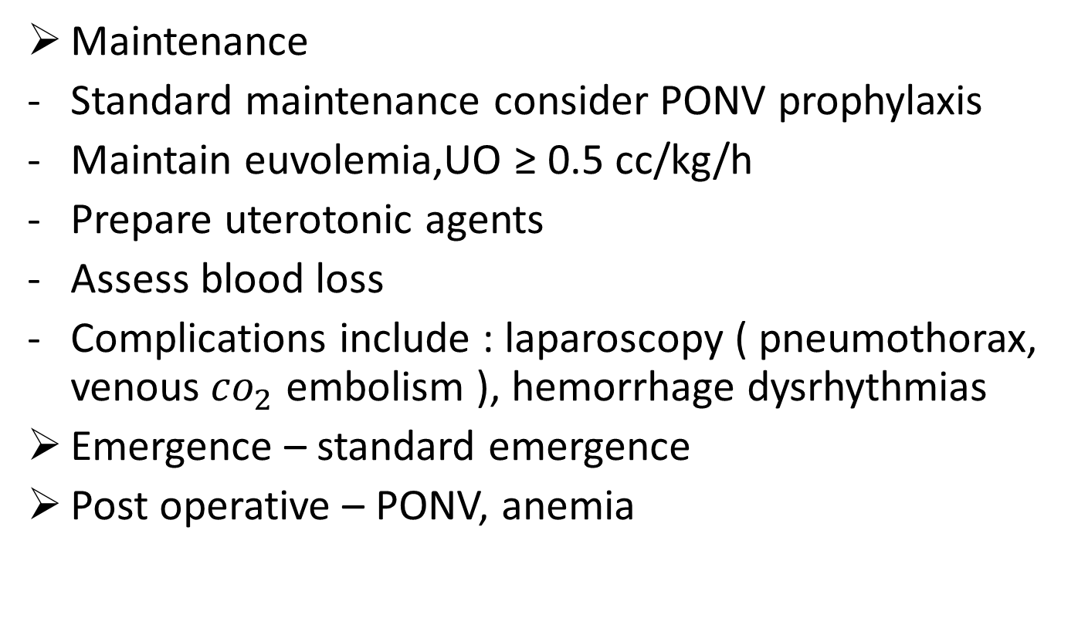
…cont’d
Maintenance
Standard maintenance consider PONV prophylaxis
Maintain euvolemia,UO ≥ 0.5 cc/kg/h
Prepare uterotonic agents
Assess blood loss
Complications include : laparoscopy ( pneumothorax, venous${ co}_{2}$ embolism ), hemorrhage dysrhythmias
Emergence – standard emergence
Post operative – PONV, anemia

Slide 19
Exploratory laparotomy / hysterectomy
Radical hysterectomy
Indication – stage IA or stage IB cervical carcinoma
- stage II endometrial and stage I vaginal
carcinoma

Slide 20
Cont’d
Preoperative
Respiratory- these tumors have been associated with cigarette smoking , check for preexisting lung disease as indicated from history and physical examination
Cardiovascular – patients > 50 years need preoperative ECG
Laboratory – CBC, blood grouping and cross match

Slide 21
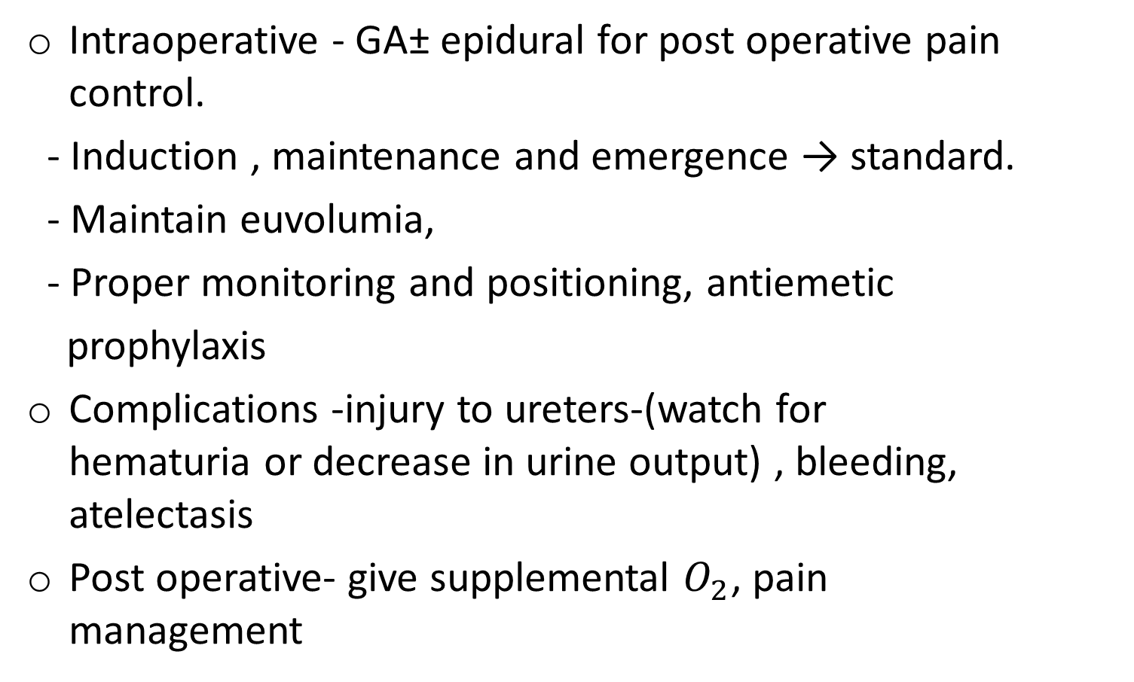
…cont’d
Intraoperative - GA± epidural for post operative pain control.
- Induction , maintenance and emergence → standard.
- Maintain euvolumia,
- Proper monitoring and positioning, antiemetic
prophylaxis
Complications -injury to ureters-(watch for hematuria or decrease in urine output) , bleeding, atelectasis
Post operative- give supplemental $O_{2}$, pain management

Slide 22
Others
Anesthetic management for dilatation and curettage (D and C), therapeutic abortion and evacuation (D and E)
Patients presenting for these procedures are generally healthy
Preoperative
Cardiovascular – hemodynamic status may be impaired secondary to uterine bleeding and patient may be septic from retained uterine products
Laboratory – Hg,HCT, blood group and Rh, cross match
Premedication – consider midazolam

Slide 23
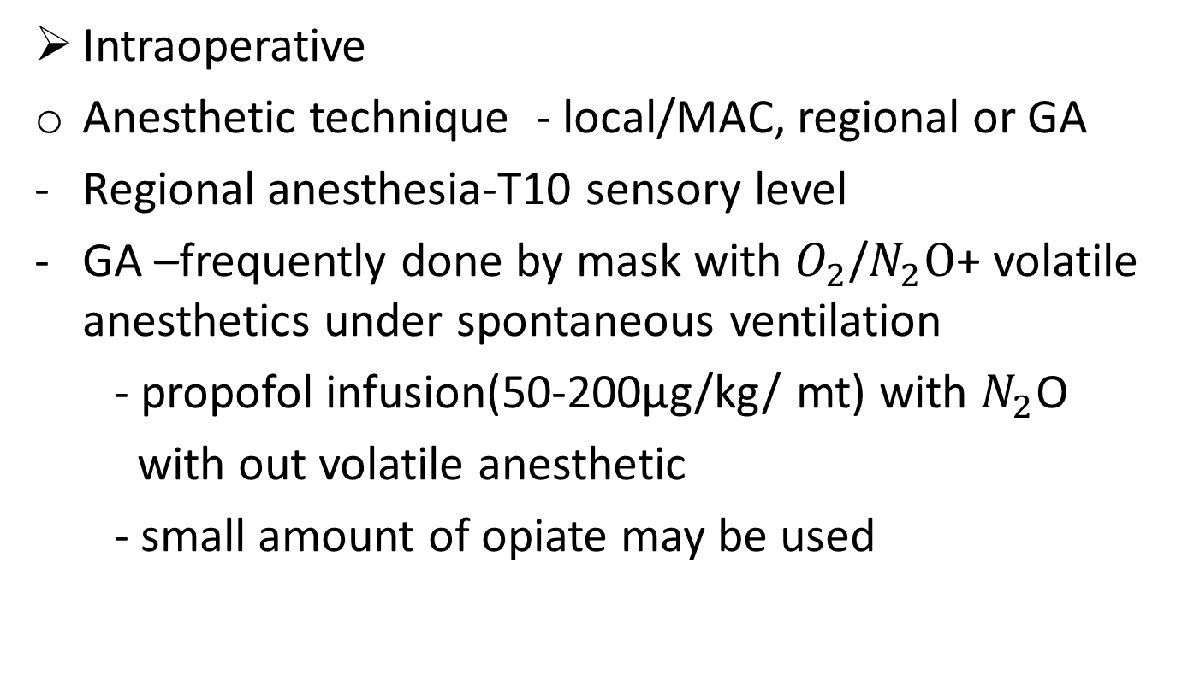
…cont’d
Intraoperative
Anesthetic technique - local/MAC, regional or GA
Regional anesthesia-T10 sensory level
GA –frequently done by mask with $O_{2}$/$N_{2}O$+ volatile anesthetics under spontaneous ventilation
- propofol infusion(50-200µg/kg/ mt) with $N_{2}$O
with out volatile anesthetic
- small amount of opiate may be used

Slide 24
Anesthetic technique…cont’d
Vagal stimulation – brady cardia when the cervix is grasped and dilated, the patient may have excessive vaginal stimulation→ stop stimulation and give atropine (0.4 mg IV) if indicated
Position – lithotomy position may worsen pulmonary function may cause nerve injury
Emergence – vomiting may occur , give oxytocin 20 – 30 U diluted in 1Lt of crystalloid or ergometrin IM

Slide 25
…cont’d
Post operative – PONV, uterine perforation with severe abdominal pain(rare),severe hemorrhage necessitating blood transfusion(rare)
Pain management – IV opiates, oral pain medications
Post operative HCT and Hg

Slide 26
Anesthesia for pregnant woman for non-obstetrics surgery

Slide 27
Introduction
Non obstetrics surgery occurs in ≈ 2% of pregnant women
Most common surgeries:
Appendectomy
Cholecystectomy
Adnexal disease – ovarian cysts
Breast or cervical disease
Trauma
Bowel obstruction
Cardiovascular or neurologic emergencies

Slide 28
Goals
Safe anesthesia for both the mother and the fetus!

Slide 29
Objective for non obstetric surgery
Ensure maternal safety
Avoid teratogenic drugs
Avoid intrauterine fetal asphaxia and
Prevention of premature labor related to the surgical procedure or drugs administered during anesthesia

Slide 30
Ensuring maternal safety
Physiological and anatomic changes (major)
Cardiovascular changes
↑cardiac output 50% (↑HR and SV)
ECG changes- left axis deviation and murmur
↑blood volume
Aortocaval compression > 20 weeks
Hypercoagulability and risk of thromboembolism

Slide 31
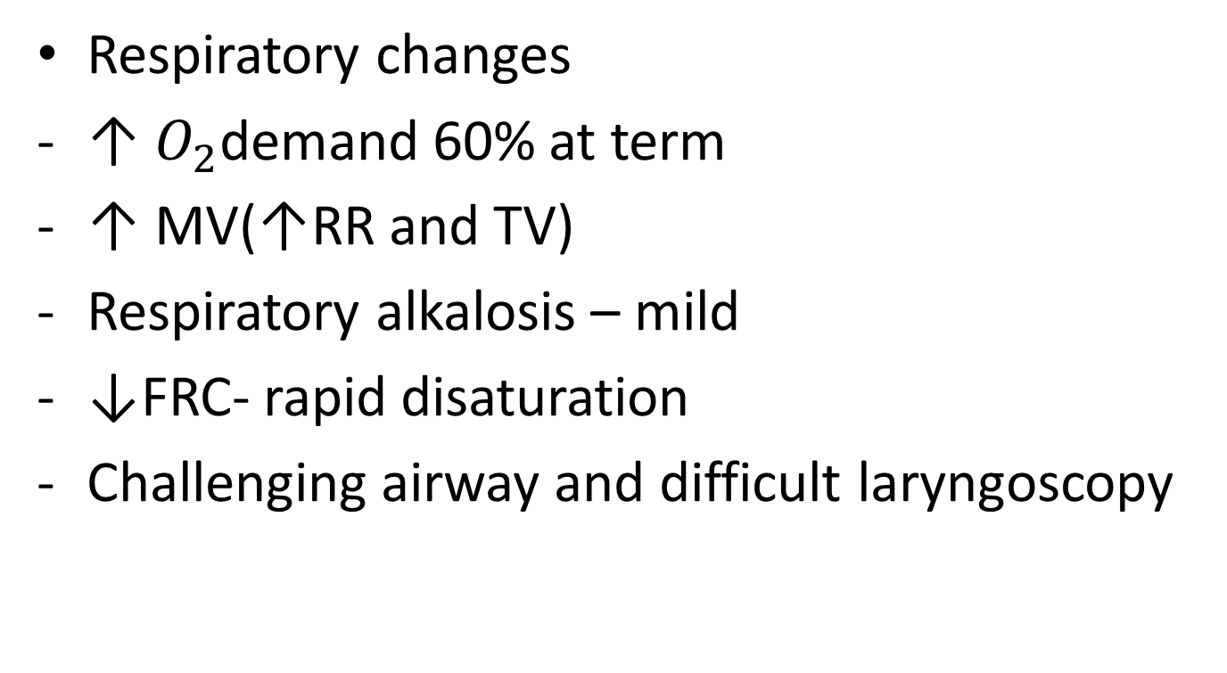
Respiratory changes
↑ $O_{2}$demand 60% at term
↑ MV(↑RR and TV)
Respiratory alkalosis – mild
↓FRC- rapid disaturation
Challenging airway and difficult laryngoscopy

Slide 32
Gastrointestinal changes
Reduced LEST
↑ed intragastric pressure
Increased incidence of esophageal reflux
↓barrier pressure
Renal
↑renal blood flow
↓serum Cr and BUN
Altered drug pharmacology

Slide 33
Teratogenicity
It is defined as any significant postnatal change in offspring after prenatal treatment
The teratogenicity of a drug depends upon:
The dose administered
The route of administration
The timing of fetal exposure
Genetic predisposition and
The species administered to

Slide 34
Teratogenicity …cont’d
Exposure to teratogen:
In the first two weeks – an all or non
phenomenon
3rd to 8th wk – organogenesis
> 8th wk – growth retardation
Teratogenicity is rare in normal clinical doses

Slide 35
Teratogenic agents in human beings
Radiation
Atomic weapons, radioiodine therapeutic uses
Infections
Cytomegalovirus, herpes virus hominis, rubella virus, syphilis, toxoplasmosis
Maternal metabolic imbalance
Alcoholism, cretinism, diabetes, folic acid deficiency
Drugs and chemicals
cocaine, coumarin anticoagulants, iodides , methimazole,mercury

Slide 36
Teratogen
Rare in normal clinical doses
Nitrous oxide
inactivates vitamin B12, a coenzyme of methionine synthetase; depresses methionine synthetase activity → may affect thymidine and DNA synthesis in the developing fetus
Teratogenic during peak organogenesis in rodents; no evidence in humans

Slide 37
Benzodiazepines
associated with a cleft lip and palate in animal studies
In human controversial!- large doses in the first trimester should be avoided
A single dose has not been associated with teratogenicity
Long term use → neonatal withdrawal may occur

Slide 38
Avoiding fetal asphyxia
Maintaining maternal oxygenation
Avoid hypoxia, extreme hyper and hypocarbia
Maintain uteroplacental circulation- dependent on maternal blood pressure and cardiac output
causes of hypotension:
Anesthetic drugs
Central neuroxial blockade
Hypovolemia
Aortocaval compression

Slide 39
Preventing premature labor
Surgery ↑s the risk of :
Spontaneous abortion
Preterm labor and
Preterm delivery
use of prophylactic tocolytic agents is controversial
Avoiding drugs that increase uterine tone

Slide 40
Timing of surgery
Avoid elective surgeries during pregnancy
If possible avoid surgery in the 1st and 3rd trimester
The 2nd trimester is the optimal time to perform surgeries

Slide 41
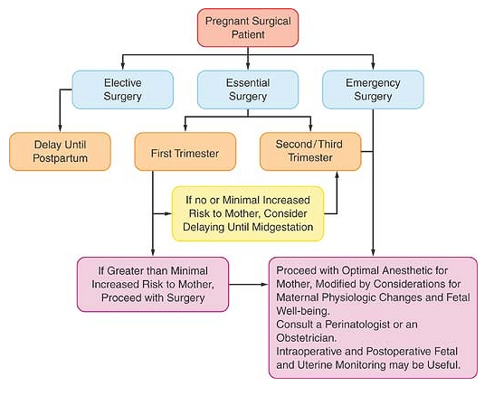
Recommendations for management of parturients and surgical procedures

Slide 42
Anesthetic consideration
Preoperative assessment
Document LMP
Pregnancy test?
Reassuring and explaining about risks to the fetus or pregnancy
Explain symptoms of preterm labor

Slide 43
Goals
Avoidance of:
Hypoxemia
Hypotension
Acidosis and
hyperventilation

Slide 44
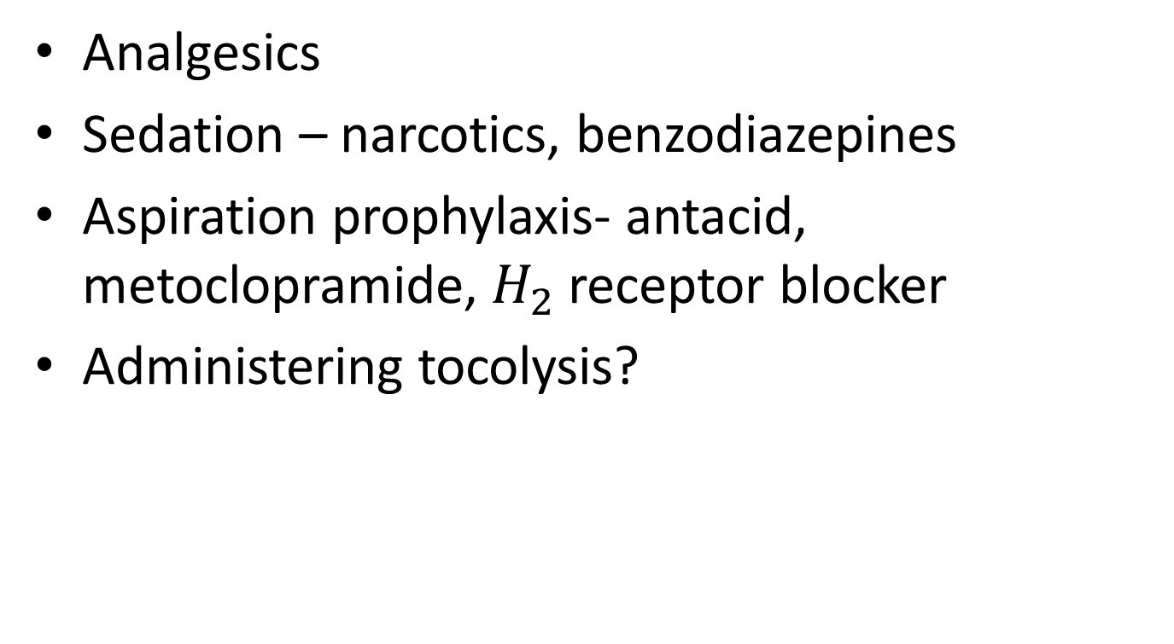
Preoperative medications
Analgesics
Sedation – narcotics, benzodiazepines
Aspiration prophylaxis- antacid, metoclopramide, $H_{2}$ receptor blocker
Administering tocolysis?

Slide 45
Choice of anesthetic
Depends on:
The mothers condition
The planned surgical procedure
No study has correlated improved fetal outcome with any anesthetic technique
When possible, local or regional anesthesia ( with the exception of paracervical block ) is preferred
Most abdominal procedures require GA

Slide 46
Monitoring
Intraoperative monitoring
Blood pressure
ECG
Pulse oxymetry
capnography
Temperature
Blood glucose for longer cases
Fetal heart rate(if technical feasible) GA is > 24 wks
If < 24 wks : preop and postop.
Peripheral nerve stimulator
Uterine activity

Slide 47
General considerations
Induction and emergence from anesthesia is more rapid than in the non pregnant state:
- Increased minute ventilation
- Decreased FRC
- Decreased MAC of volatile agent
Supine hypotensive syndrome can occur as early as the second trimester
Increased effect of local anesthetics during pregnancy
Increased risk of aspiration

Slide 48
General anesthesia
Full preoxygenation
Left uterine tilt
Rapid sequence induction, smaller ETT
Use appropriate drugs
Safe drugs : thiopental, propofol, morphine, petidine, fentanyl, succinylcholine and NDMR
Ketamine increases uterine tone
Avoid hyperventilation – relative hypocapnia
Inhalational agents < 2 MAC
reversal of relaxants
Compression stockings

Slide 49
Regional anesthesia
Is preferable
Prevent hypotension
Adequate fluid replacement
Uterine displacement
Decrease neuraxial local anesthetic dose- 30%
Choose vasopressors based on maternal heart rate

Slide 50
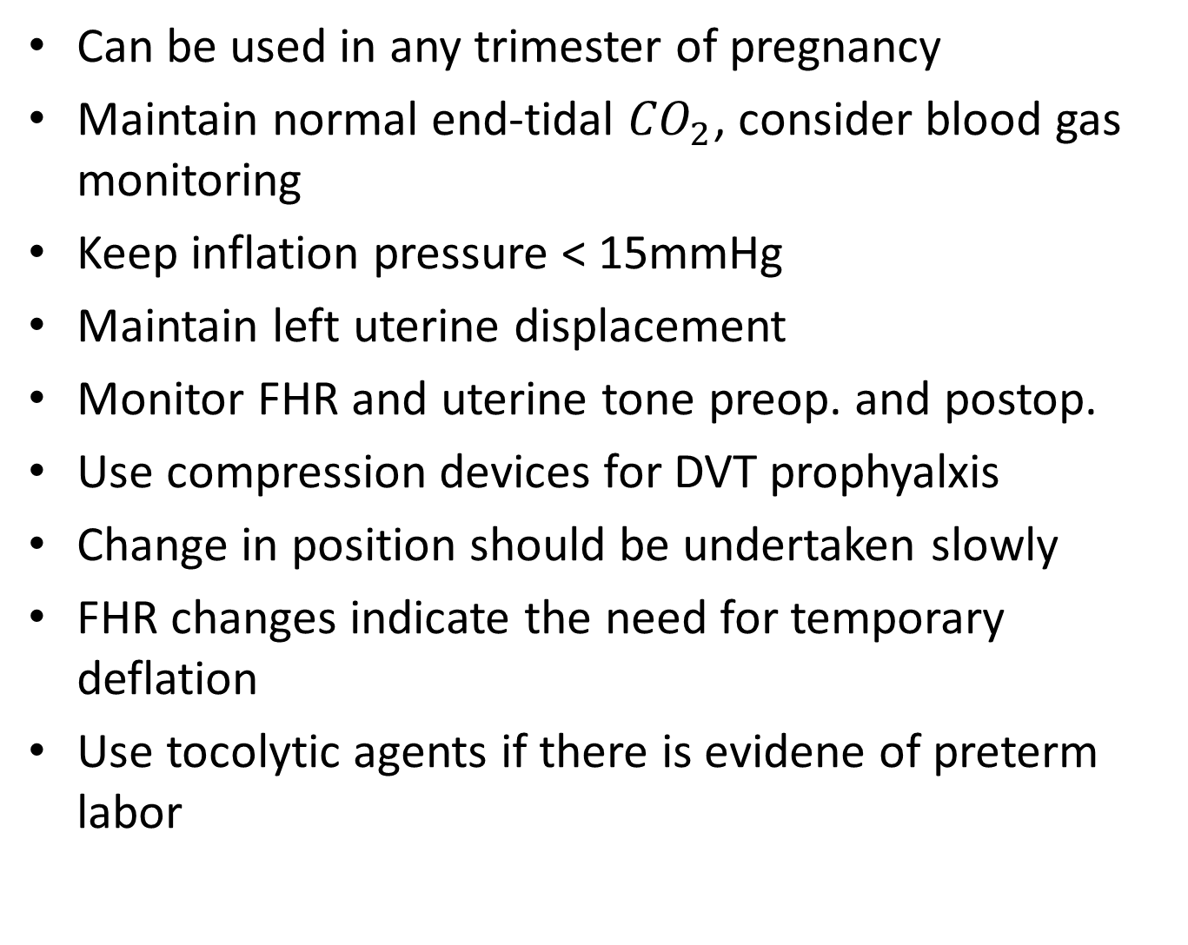
Laparoscopy
Can be used in any trimester of pregnancy
Maintain normal end-tidal ${CO}_{2}$, consider blood gas monitoring
Keep inflation pressure < 15mmHg
Maintain left uterine displacement
Monitor FHR and uterine tone preop. and postop.
Use compression devices for DVT prophyalxis
Change in position should be undertaken slowly
FHR changes indicate the need for temporary deflation
Use tocolytic agents if there is evidene of preterm labor

Slide 51
Post operative
Continue monitoring fetal heart rate and uterine activity
Maintain maternal oxygenation and LUD
Proper pain management: systemic or neuraxial opioids, acetaminophen or neural blockade
Avoid use of NSAID after 32 wks
Risk of premature closure of ductus arteriosus
Maintain hydration
Prevent thromboembolism
Encourage early ambulation
Pharmacologic prophylaxis – SQ low molecular weight heparin

Slide 52
Puerperium
The 1st 6 wks after delivery
Avoiding elective surgery in the puerperium period is preferable
If surgery is indicated select drugs which are safe during breast feeding
Propofol thiopental and volatile anesthetic agents are found in significant amount in breast milk
Neuromuscular blocking agents not excreted in breast milk
Advise the woman to express and discard the 1st sample of milk and to resume infant feeding
Antiemetics - use with caution
Local anesthetics excreted in breast milk in a less harmful amount
breast feeding can be continued normally

